Slide 1
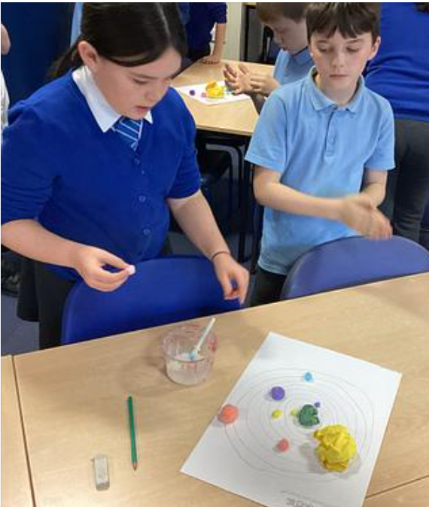
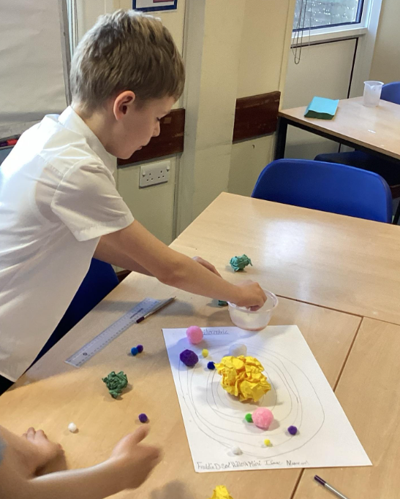
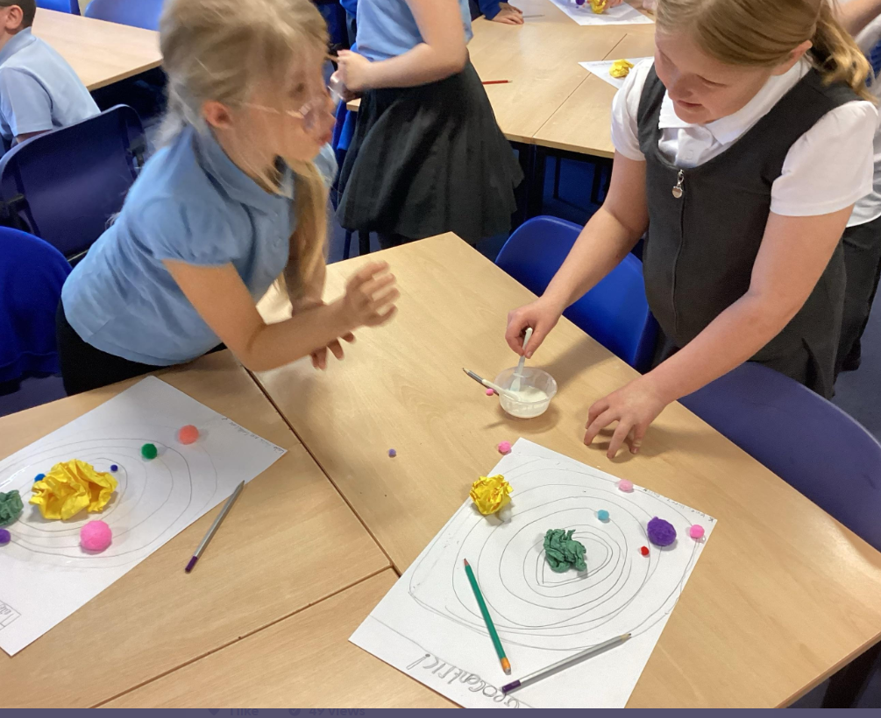
Solar system models
Children created their own Geocentric and heliocentric models to show the correct centre of our solar system is the Sun.

